Slide 1
L-J Model of Argon

Slide 2
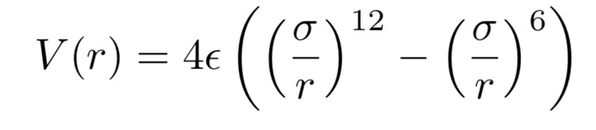
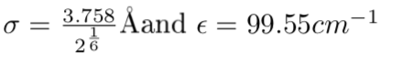
12-6 form of Lennard-Jones potential

Slide 3
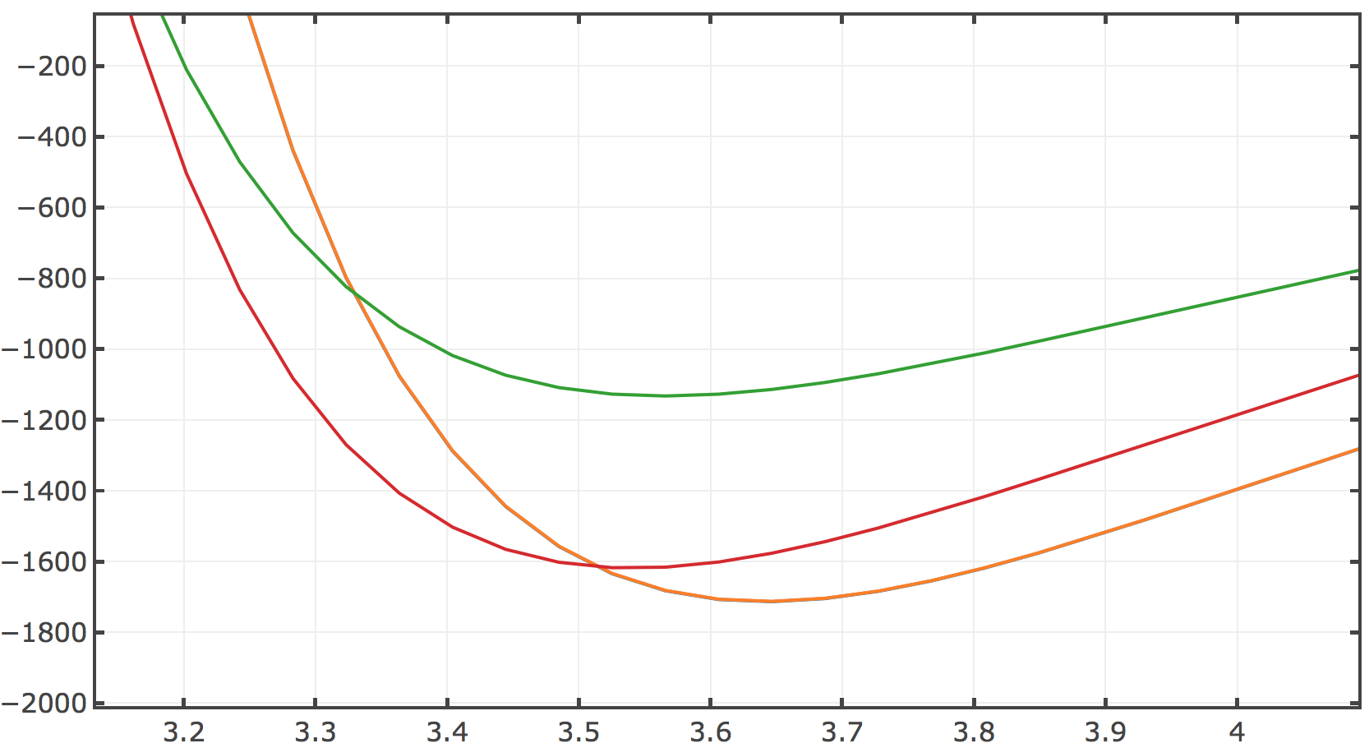
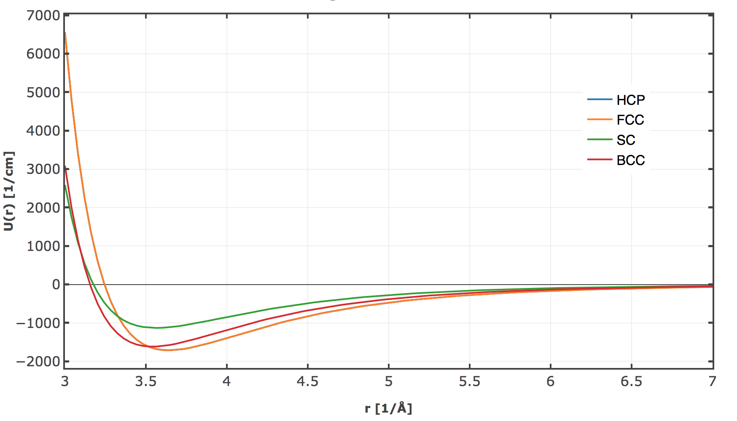
L-J Model

Slide 4

FCC or HCP?
 | Spacing Å | Energy cm⁻¹
SC | 3.56 | -1132.4812
BCC | 3.52 | -1617.4023
FCC | 3.64 | -1712.5192
HCP | 3.64 | -1713.2478
0.00042

Slide 5
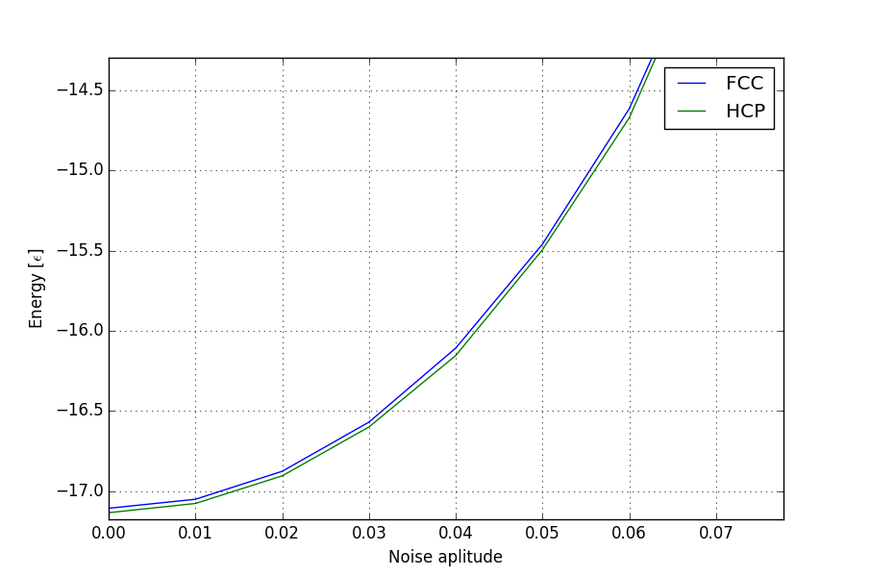
Adding Noice to the lattice

Slide 6
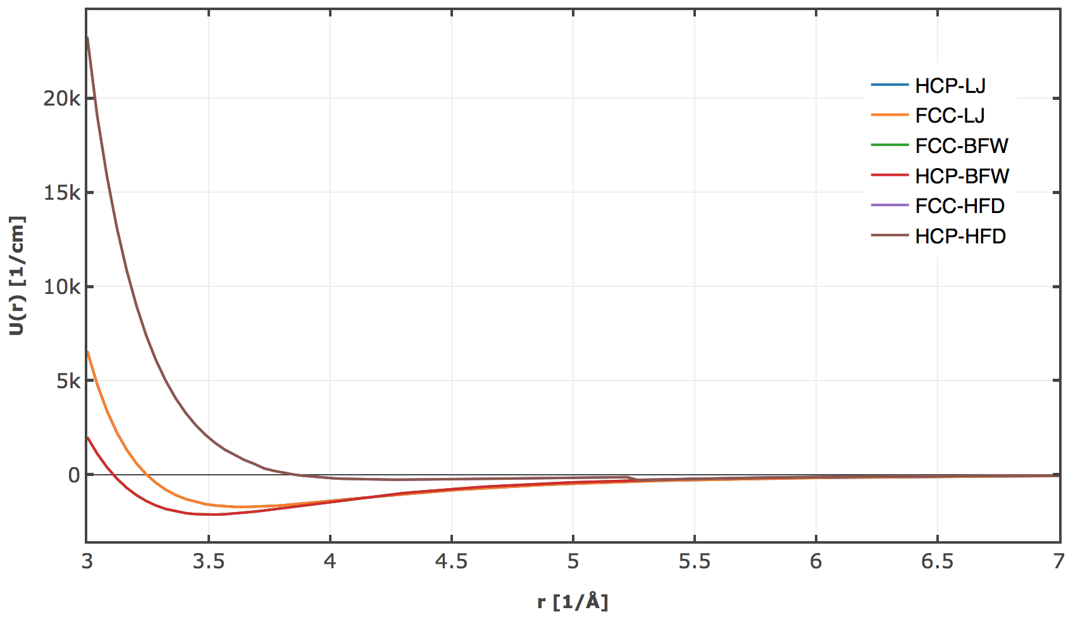

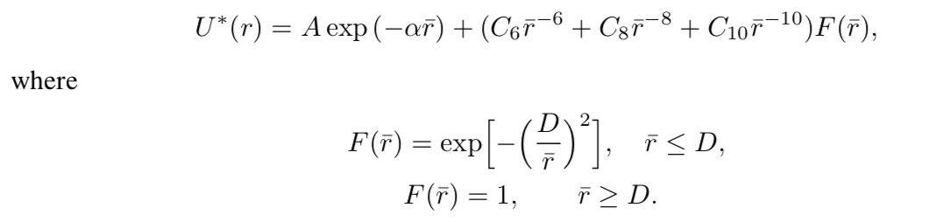
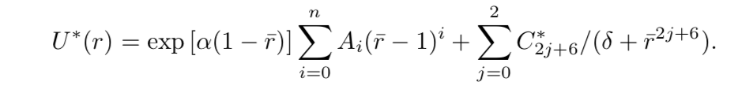
Using different potentials
HFD
BFW
0.00025

Slide 7
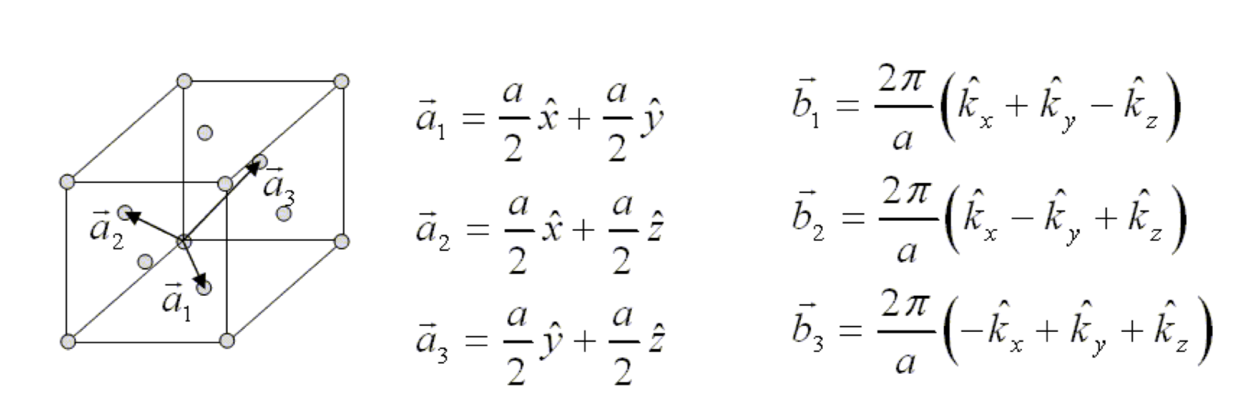
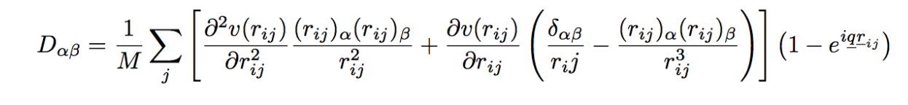
Phonon Dispersion
FCC

Slide 8
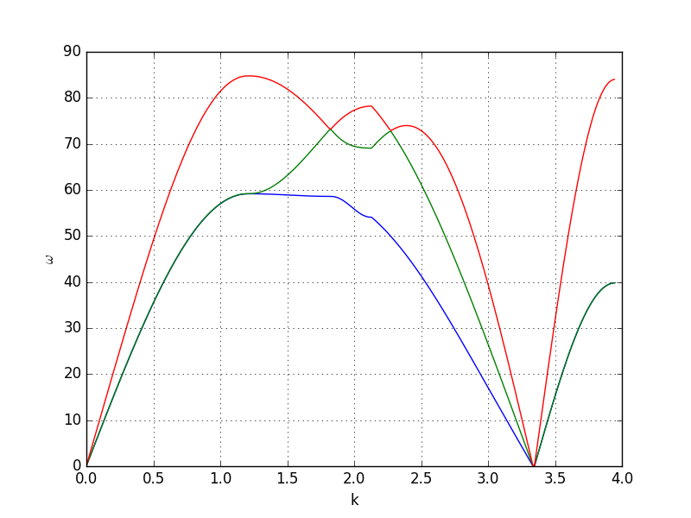
Phonon Dispersion
𝚪
X
W
K
𝚪
L

Slide 9
Phonon Dispersion
𝚪
X
W
K
𝚪
L
184
123

Slide 10
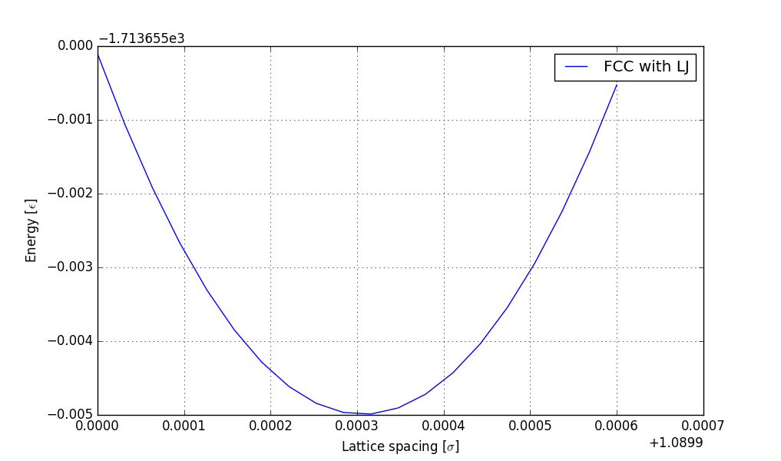
Sound Velocity :: TODO
184<V_s<213

